Slide 1
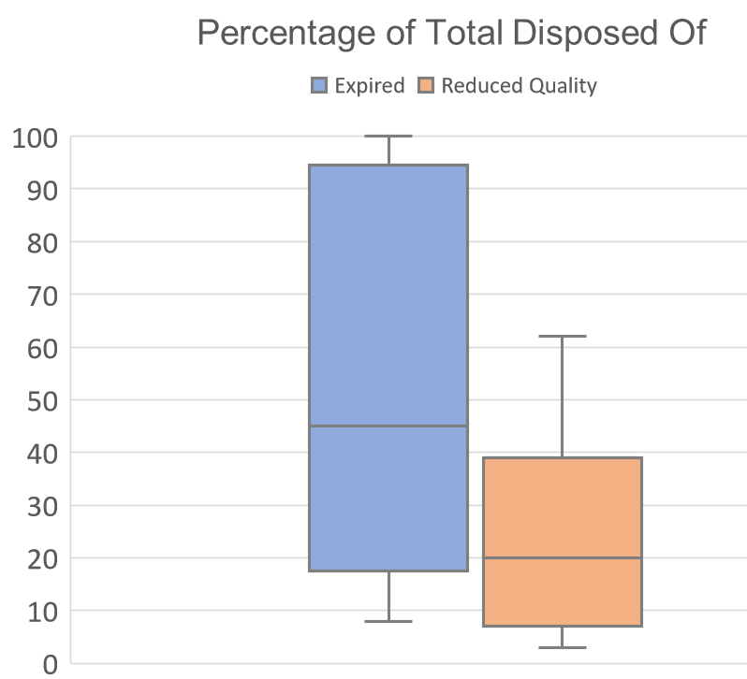
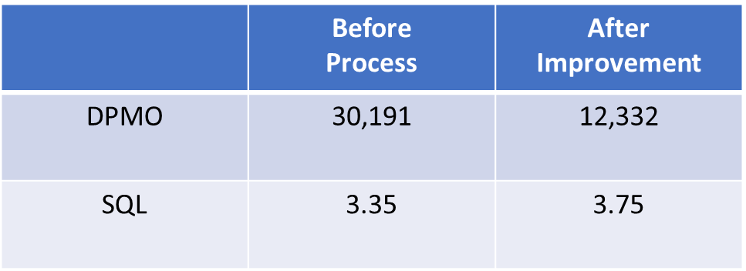
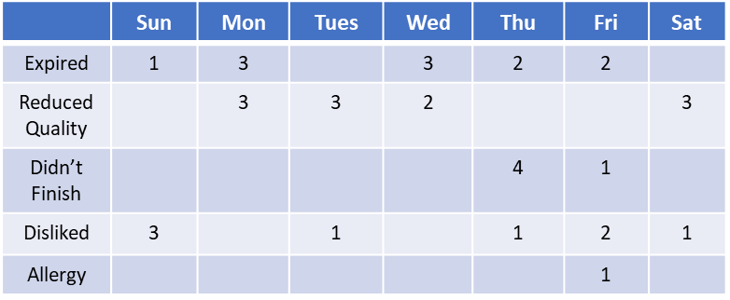
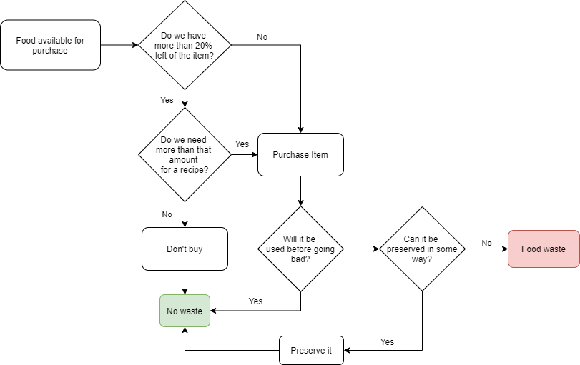
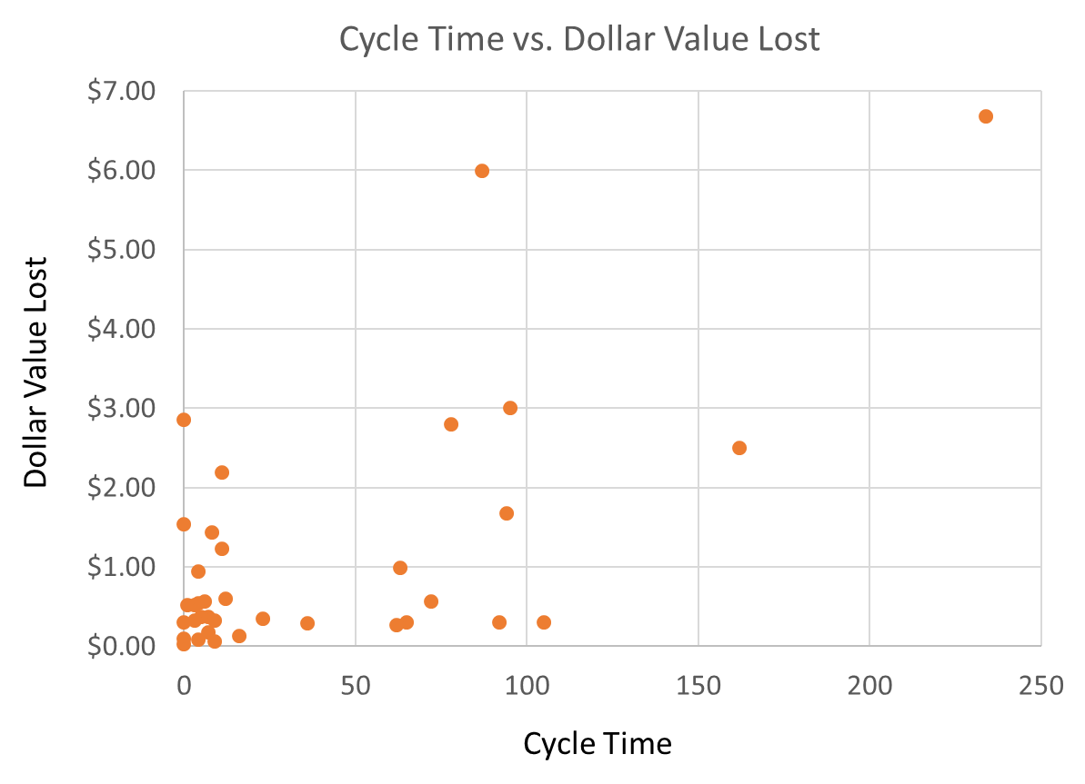
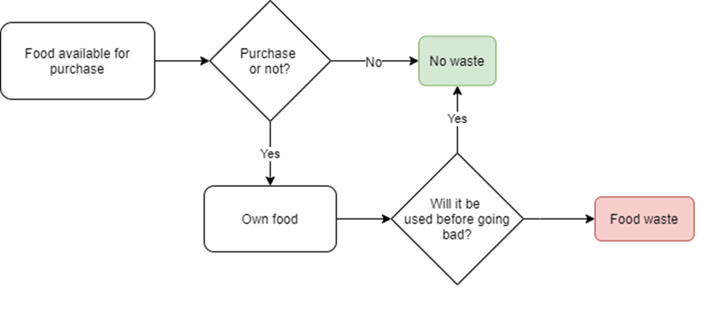
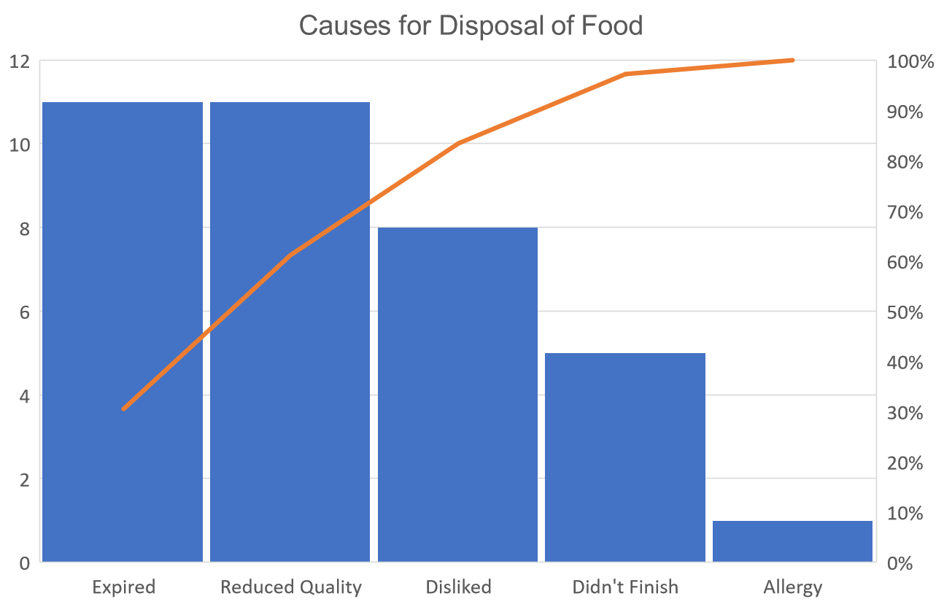
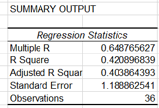
Process Improvement Project: Food Waste Reduction
Emma Gillen
Key Dates → | Define: 1/15 | Measure: 1/15 – 2/25 | Analyze: 2/25 – 2/27 | Improve: 2/27 – 3/12 | Control: On-Going
DEFINE Problem Statement: My household is producing too much food waste, causing us to waste money on excess products. The goal is to cut the dollar value in half. Business Impact: I estimate that I throw away about 5% of the food I purchase and spend around $200 a week on food. With that estimation, I am losing approximately $10 a week or $520 a year. |  | MEASURE | ANALYZE | IMPROVE
CONTROL
SQL Up 0.4
Tracked the reason food is disposed of and on which day.
The spread of the percentage of food thrown away is much wider for expired food than reduced quality goods.
SQL = 3.35
(1)
(2)
Continue the two steps implemented in the improve stage.
Further research could be done to determine if the positive changes are statistically significant.
Visually there may be a trend between dollar value lost and cycle time, but the regression is weak.
I implemented two changes:
Only make a purchase if we own less than 20% of the original good OR need more than what we own for a recipe
Preserve goods if they won’t be used ASAP and risk expiring
Foods expiring and reducing in quality are the leading causes of disposal.
I focused on these two factors.

Slide 2
DEFINE: Goals, Inputs/Outputs, etc.
My household produces too much food waste. This is causing us to waste money on excess products.
My goal is to reduce the dollar value of what is wasted. I want to cut the amount of money wasted in half.
I would estimate that I throw away about 5% of the food I purchase (including groceries, carry in, dining out, coffee, alcohol, etc.). I estimate my household spends around $200 a week on food. With these estimates, I am losing approximately $10 a week or $520 a year.
My key output is the dollar value of the food I throw away.

Slide 3
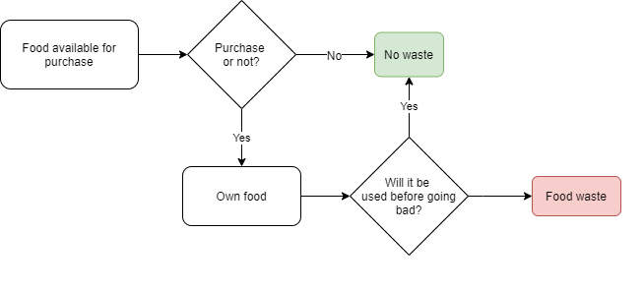
DEFINE: Original Process Flow Chart
This chart shows the current process before the improvement project.
No

Slide 4
Measure: Data Stratification Tree
Questions about the process
Is food waste affected by the day of the week?
Stratification Factors
(X Variables)
Day of the week
Measurements
The date that an item is thrown away
How much of a whole item do we normally throw away?
What is the most common explanation for throwing something away?
How long does it take between buying something and throwing it away?
Percentage thrown away
Reason for throwing away
Cycle time
The original weight and the weight that is disposed of
Reason for throwing something away from a list of determined options
The day an item is purchased and the day it is disposed of
What item do we throw away most often?
Type of food
Record the type of food when it is thrown away

Slide 5

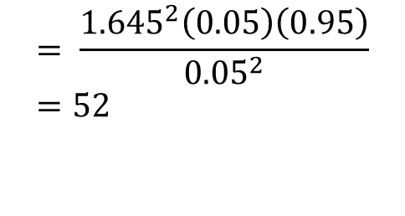
Measure: Data Definitions
Data | Discrete or Continuous | Data Collection
Day of the week | Discrete | Date recorded when disposed of.
Type of item disposed of | Discrete | Categorized when disposed of.
Reason for disposal | Discrete | Categorized within predetermined categories when disposed of.
Original cost | Continuous | From receipt.
Original oz | Continuous | From packaging or menu information.
Cycle length (between purchase and disposal) | Continuous | Day purchased from receipt. Day disposed of recorded at time or recording.
Percentage disposed of | Continuous | Measured and recorded when disposed of.
I was recording data every time I threw away an item. Throwing away an item or not is a discrete measure. In my initial set up, I estimated that I dispose of 5% of the food purchased. I would accept a confidence of 90% and a margin of error of 5%. With these values and using the sample size formula. I aimed for a sample size of 52.
I am going to minimize error by measuring myself as well as having my boyfriend repeat my measurements when possible. In addition, I am confirming established values with what is printed.
$$= \frac{{1.645}^{2}\left(0.05\right)\left(0.95\right)}{{0.05}^{2}}=52$$

Slide 6
Measure: Check Sheet
 | Sunday | Monday | Tuesday | Wednesday | Thursday | Friday | Saturday
Expired | 1 | 3 |  | 3 | 2 | 2
Reduced Quality |  | 3 | 3 | 2 |  |  | 3
Didn’t Finish |  |  |  |  | 4 | 1
Disliked | 3 |  | 1 |  | 1 | 2 | 1
Allergy |  |  |  |  |  | 1
I used a check sheet to distinguish between the different reasons for disposal. Each time I disposed of an item I checked an instance of the reason. I tracked these for each day of the week to see if any pattern emerged.
Although my goal was 52 samples, I only collected 36. This limits the power of my analysis.

Slide 7
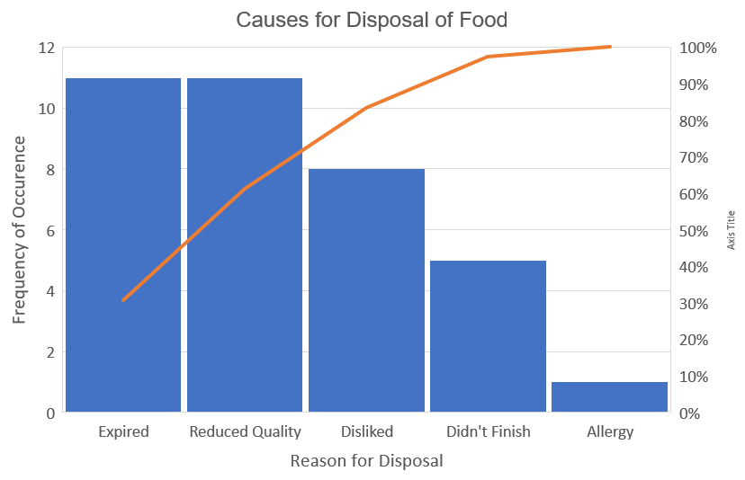
Measure: Pareto Diagram
I made a pareto chart to visualize the frequency of occurrence of each reason of disposal.
Looking at the pareto chart, 80% of the problem is caused by foods expiring and foods reducing in quality.
It seems that we do not often buy foods we don’t like or prepare food we don’t finish.
We had one instance of an allergy which is an unexpected result, largely outside of our control.

Slide 8
Analyze: Scatter Plot
Next, I made a scatter plot of the cycle time vs the dollar value lost for each instance of disposal.
Visually, the scatterplot suggests that there could be a positive relationship between cycle time and the dollar value lost.
Logically, this made sense. We could be forgetting items for a long time and losing a large value when they are rediscovered.
(e.g. forgetting leftovers in the back of the fridge).
Dollar Value Lost
Cycle Time

Slide 9
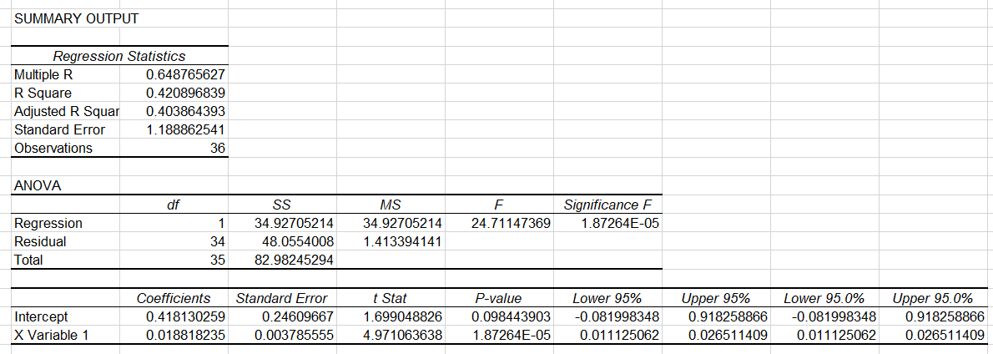
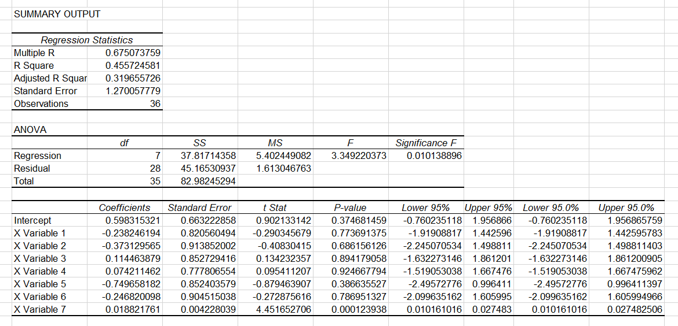
Analyze: Regression
1st
I decided to investigate the relationship between cycle time and dollar value further. I did a simple linear regression, with
X = cycle length
Y = wasted cost.
My results are to the left. I found an R of 0.648. As a rule of thumb, R needs to be more extreme than 0.7 to be significant.
2nd
To try to improve the model, I did a multiple linear regression adding day of the week as a categorical variable.
X = cycle length, day of the week
Y = wasted cost
My results are to the right.
Even with the added factor, the model is lacking. There is not enough information to determine a relationship between these two variables.

Slide 10
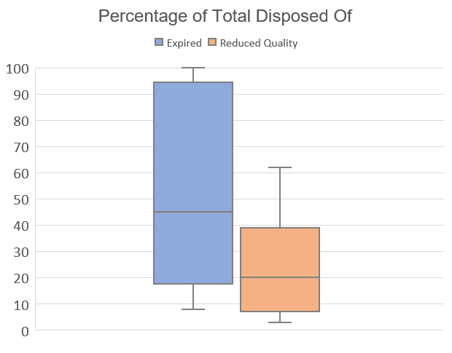
Analyze: Box and Whisker Plot
Looking back to the Pareto chart, I constructed a box and whisker plot showing the percentage of the food disposed of within the main two causes.
Reduced quality goods tend to be mostly used up by the time they are thrown away. In many cases, the reduced quality goods are replaced before they fully expire but are otherwise lacking in some way.
Therefore, we are going to implement a household rule that we don’t replace a product if we have 20% left at home (the mean amount currently disposed of).
For expired goods, the percentage thrown away has a much larger spread.
To address this, we are going to increase efforts to preserve foods before they expire.

Slide 11
IMPROVE: Proposed Process Flow Chart
This is the new process flow chart after implementing the process changes.
No

Slide 12
Improve: Sigma Quality Level
I considered any food item purchased an opportunity. A defect was throwing part or whole of a product away for whatever reason.
The original SQL was 3.35. After the process, the SQL increased to 3.75.
This is a positive sign, but more data would need to be collected to reach a stronger conclusion. Only two weeks of data were collected for the improve stage.
 | Before Process | After Improvement
DPMO | 30,191 | 12,332
SQL | 3.35 | 3.75

Slide 13
CONTROL
So far, the changes made in this process improvement project seem to be helping. The two changes implemented in the improve stage should be continued.
However, although the solutions seem to be helping, the population measured was smaller than ideal. More data should be gathered to reach a stronger conclusion.

